Slide 1

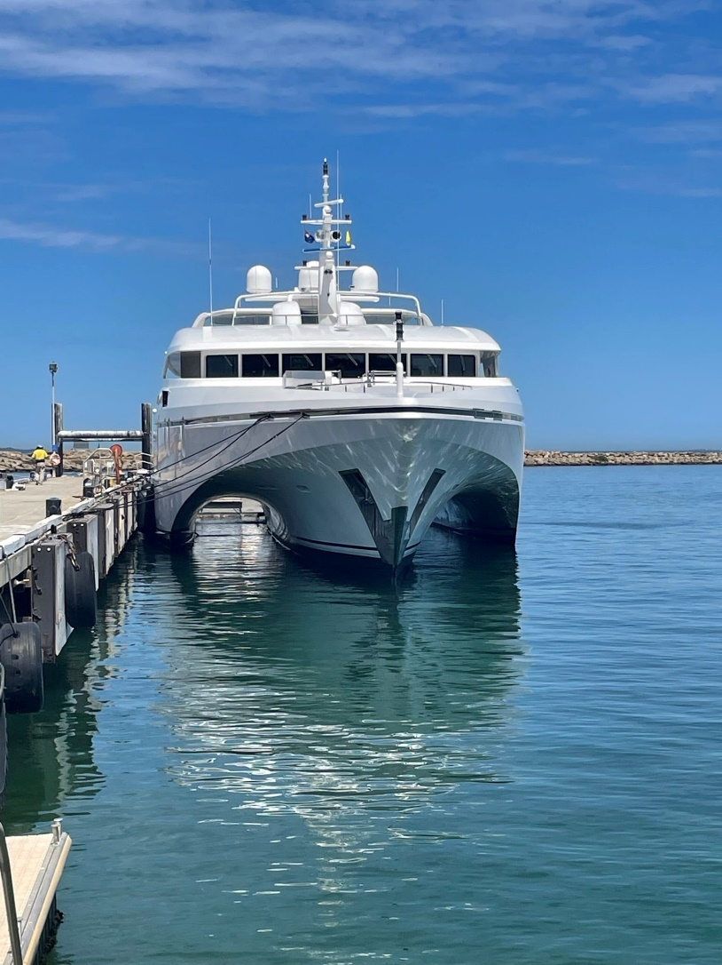

Employee/Contractor Induction Manual
HR 01 - Updated 24/9/2025

Slide 2

Introduction
The safety and health of all people working at Echo Marine Group is important to the company’s general beliefs and values.
This induction is for all Echo Marine Group employees, our tenants and their employees, contractors and visitors who will be working or visiting Echo Marine Group in Henderson.
On arrival at Echo Marine Group, you will need to present your AMC CUF Security Access Pass to the security guard. Visitors, contractors and guests are required to sign in and out. Employees clock in and out via the payroll time clock.

Slide 3
Work Health, Safety and Environment Policy
At Echo Marine Group we are committed to conducting our business in a manner that prevents injury or illness to employees, contractors, customers and the general public.
We are committed to conducting our business in a manner that minimises adverse environmental impacts which could be caused by our activities.
The company has established comprehensive Work Health, Safety and Environment Policies which will be implemented through the positive and active participation of all levels of the organisation.
To this end we will:
Establish and maintain a WHSE management system that facilitates a structured approach to the management of WHSE risk.
Comply with relevant Legislation, mandatory codes of practice and standards applicable to each country in which we operate.
Promote a safety culture that encourages people to actively manage health and safety risk through education, instruction, information and supervision.
Clearly define and communicate responsibilities in relation to health and safety to all levels of the organisation.
Provide sufficient information, instruction, training and supervision to enable all employees to identify, minimise and manage hazards in the workplace.
Ensure that incidents and hazards are promptly reported, investigated where appropriate, and control measures are put in place to eliminate the chance of a recurrence.
Echo Marine Group recognises that the objectives of this policy statement can best be achieved through effective consultation, communication and co-operation between managers, supervisors, employees, contractors and customers - working together to continually improve WHS performance.

Slide 4
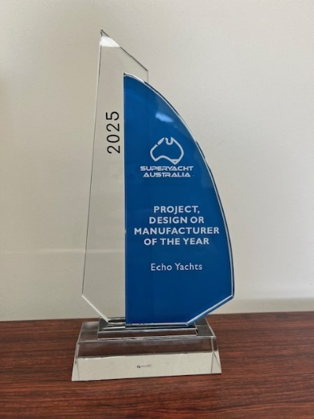
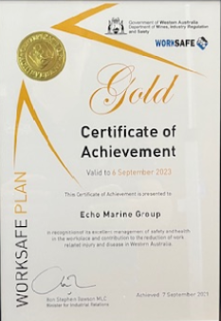
WHSE and your commitment
At Echo Marine Group we expect you to commit to working within our WHSE policies and procedures. Your commitment will be:
To help us continue to do this, we expect a commitment from all people attending our workplace to work safely to these systems.
We expect supervisors to ensure supervision of work tasks and ensuring compliance with these systems.
We expect a commitment from everyone to report all incidents and accidents and assist in investigating these reports.

Slide 5


Drugs and Alcohol
All employees and contractors shall abide by the provisions of the Echo Marine Group Drugs & Alcohol Policy and adhere to the Drugs & Alcohol Procedure and its codes of behaviour that support the policy. Failure to do so may result in termination of your employment or contract. Echo Marine Group reserves the right to undertake drug and alcohol testing for employees or contractors on a random or with cause basis. This policy is displayed on the safety notice board at the mezzanine entry.
Smoke Free Work Environment
Echo Marine Group is a non-smoking workplace.
There will be no smoking, including vaping, on the vessel, Jetty, or within AMC and Echo Marine Groups leased areas, as well as no smoking anywhere on site except in the designated signposted smoking area, located on the lawn far south side of the main entrance.
Policies
All policies are displayed on the Safety Notice Board in the Mezzanine level entrance.

Slide 6

Bullying and Sexual Harassment
Echo Marine Group does not tolerate harassment, sexual harassment, bullying, sex-based harassment, bullying or conduct which creates a hostile work environment. You must familiarise yourself, and comply with, the Echo Marine Group Sexual Harassment and Bullying Policy.
Any behaviour that involves violence, for example physical assault or the threat of physical assault, will be reported to the police.
If you would like to raise a concern for yourself or anyone else in the workplace you can talk to:
Your supervisor
The HSEQ Advisor
The HR Manager
Any Senior Manager you feel comfortable talking to

Slide 7
Site Access & Signing In/Out
Pedestrian access is through the Pedestrian Gate to the Left-Hand side of the main gate next to the security guard’s office. All staff and contractors who will be working on site will require a valid AMC Access Pass.
EMG Staff
All staff must clock in at the start of the day and out at the end of the day. If you need to leave the site during lunch for personal appointments, please seek approval from your supervisor and clock out/back in again.
Contractors/Visitors
All contractors must sign in and out each day using the electronic visitor register located at the security gate or register using the signposted QR codes.

Slide 8


Emergency Procedures
Fire Emergency – Raise the Alarm by yelling “Fire, Fire” or describe the type of risk or hazard. Attempt to extinguish the fire ONLY IF IT IS SAFE TO DO SO. If evacuation required, proceed to the Emergency Muster Point and await further instructions. Do not attempt to re-enter the workplace unless authorised by the Chief Warden.
Medical Emergency - Raise the alarm yourself or gain the attention of the nearest person and have them raise the alarm with management.
Advise them of your location, the number of people involved and the nature of the emergency.
If safe to do so, render whatever assistance you are able. Do not attempt to move the injured person unless it is to protect them from further injury.
Await further instructions and advice. Echo Marine Group will ensure sufficient personnel are trained in First Aid and advanced resuscitation. The below symbol identifies the location of the First Aid Station.

Slide 9
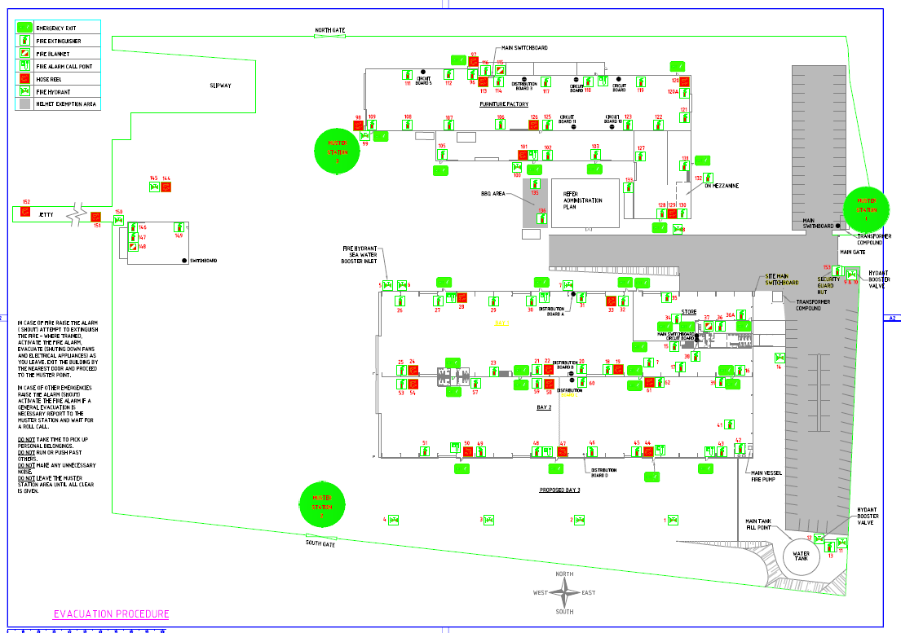
Emergency Evacuation
Evacuation muster points are highlighted by green circles in the map below.

Slide 10
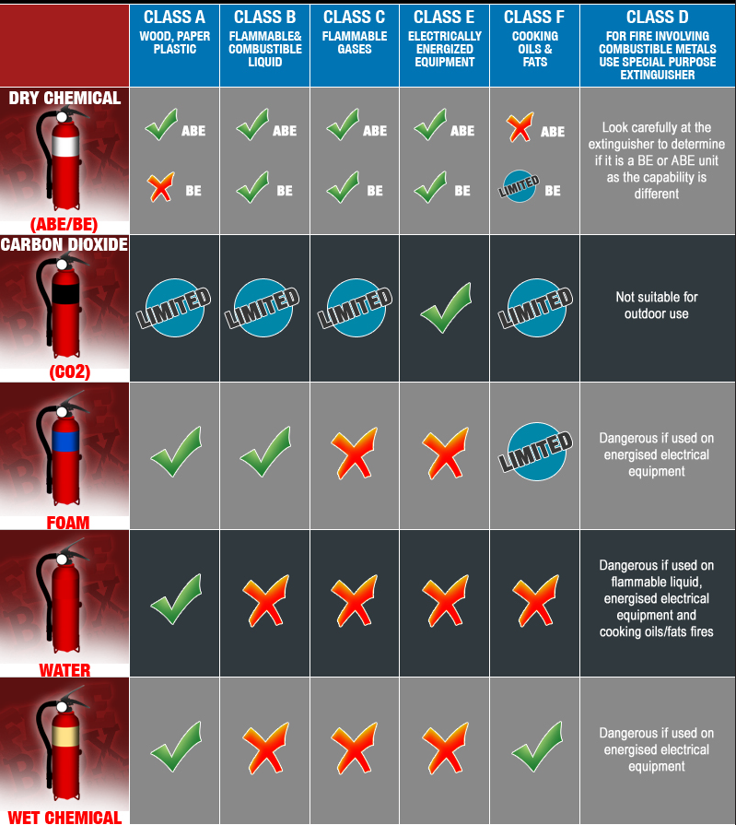

Fire Prevention
Fire Emergency – Before attempting to extinguish a fire make sure it is safe to do so. Never attempt to extinguish a fire if it means putting yourself at risk of harm or injury. Evacuate the area immediately if there are chemicals or explosives present. Echo Marine Group is equipped with Dry Powder extinguishers, fire blankets and fire hoses.
Fire hoses can only be used on fires that have a fuel source of wood, textile or paper . Do not use on fires resulting from flammable liquids, vapours, gas or that involve live electrical apparatus.
Fire blankets are in all kitchen areas to be used in the case of a cooking fire.

Slide 11
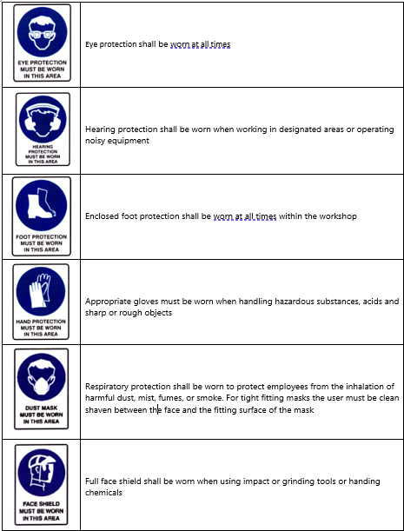
PPE
If you enter an area where this signage is displayed, you must wear the indicated PPE.
The minimum requirement across the site is hard hat, glasses, hearing protection, long pants and hi-vis.

Slide 12
Accident/Incident/Near Miss Reporting
All accidents, incidents or near misses must be reported.
Some examples include:
Chemical Spills
Security Incidents
Fuel Spills
Wastewater Spills
Motor Vehicle Incidents (including mobile plant)
First Aid Injuries

Slide 13
Accident/Incident/Near Miss Reporting
Step 1
Incident reports are made to your supervisor within 10 minutes of the incident occurring.
Step 2
Preserve the incident site if safe to do so. Any spill should be contained.
Step 3
Complete Accident/Incident/Near miss form OSH 02.
Step 4
Participate in investigation if required.

Slide 14
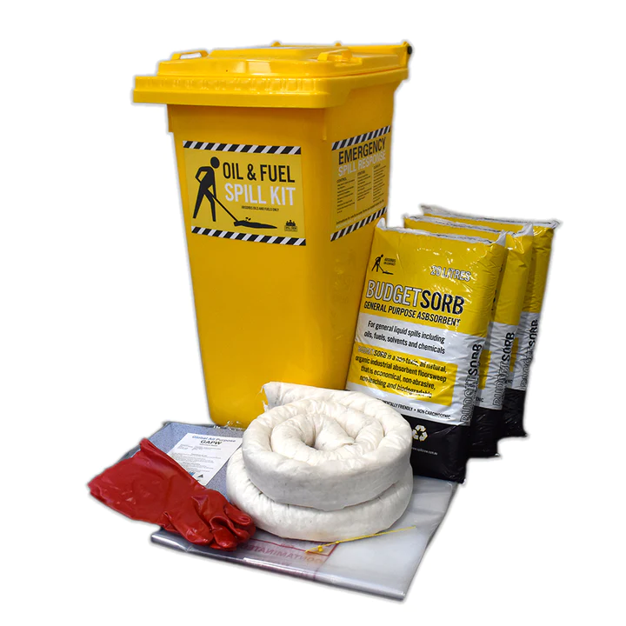
Spills
A spill kit is mandatory for any work where chemicals and fuels will be used, particularly when refuelling.
Spill kits are located throughout the bays and additional kits can be found in the stores. If you check out a spill kit from the store, please return it on completion of your task.
All spills contribute to pollution of the environment; please ensure you clean them up and report them.
Environmental Management
Ensure bin lids are kept closed to prevent rubbish being blown around site. If you see loose rubbish, please pick it up.
No Wastewater, vessel wash down water or any other by product is to enter storm water drains on the hard stand area

Slide 15
Mobile Plant Equipment
Any person operating mobile plant is expected to hold a valid license.
All pre-start inspections shall be conducted, and all documentation completed prior to commencing work.
Scaffolding – Scaffolding is only to be erected or dismantled by a licenced Scaffolder. Any changes to scaffolding must be referred to Site Services.
Crane Operation – Cranes can only be operated by a person once they have completed our in-house training, and the person is deemed competent by the nominated Echo Marine Group employee.
Contractors are not permitted to use Echo Marine Group mobile plant equipment without prior permission from the Production Manager or Site Services.

Slide 16


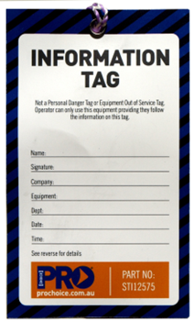
Electrical Safety
Only qualified and authorised persons are permitted to carry out electrical work.
All portable power equipment & extension leads,
including contractor equipment, must be tagged
& tested every 3 months. EMG uses this colour code.
Echo Marine Group uses three different types of safety tags:
Equipment is isolated for maintenance or repairs. Can only be removed by the person who placed it.
Equipment is faulty or unsafe. Tag can only be removed by the person who placed it or an authorised person
Used to advise workers about conditions that may affect how they work with this tool in the workplace

Slide 17
Permits to Work
Permits to work are required for any works involving confined space entry or hot works. Permits must be completed and signed off prior to commencing these works
Confined Space Entry
All persons required to enter a confined space or act as a sentry must be suitably trained and certified.
Echo Marine Group does not maintain a Confined Space Rescue Team. If a rescue incident arises then 000 is called to respond.
Hot Work Permit
Is mandatory for any works that:
Involves an open flame or that creates sparks
All welding and cutting
Electric induction heating
Bunkering of vessels
Refuelling plant and equipment with more than 100 litres

Slide 18


Hazardous Substances
All hazardous substances are to be stored safely
All hazardous substances brought onsite are required to have a valid Safety Data Sheet (less than 5 years old with an Australian emergency contact) and a copy is to be supplied to EMG
All contractors and vessels must maintain a Chemical Register and submit a copy (or updated copy) to EMG any time chemicals are bought onsite
Any spill is to be reported to the Production Manager within 10 minutes
Any hazardous substance bought onsite by a contractor are to be removed at the completion of works.

